Slide 1


Scott Potter
(former) Head of Digital Engineering
To Autonomy & Beyond
Considerations for Leaders and Senior Management as their Teams Grow their
Capability, Responsibility and Autonomy
Notes:
Hi, I’m Scott Potter
How have you found it? Enjoyed some of the talks?
I’m with you for the next 30 mins, so hopefully I can give you some useful insight into how I approached a substantial dept. transformation with DevOps at it’s core. I’m not planning to tell you how you should do it,
I hope to share an overview of some of the things I did and the underlying principles that guided my approach.

Slide 2
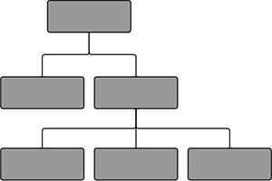








Scott Potter – To Autonomy & Beyond
The Company & Organisation
Notes:
To Autonomy and Beyond -so what does that mean?
In Truth, I was asked to talk and I said ‘No’. Then after a few days, and after reading some interesting LinkedIn discussions, I felt a bit selfish not stepping up.
So I got introduced to Gene Kim and took him through what I was thinking of talking about, expecting him to say “Thanks but No Thanks”…but he didn’t!
And then I was chased up for a title…Crikey, I’ve only just thought about what I might say.
Standing on the train platform, early one sunny morning this title came to me. A crucial aspect of how I try to manage is to provide the right env. for Ownership Behaviour
to flourish. Autonomy and self sufficiency are a vital ingredient to this…and the DevOps mindset compliments this nicely.
What are we going to talk about today?
Set the context – Company & Org
A bit about me and where I fitted in.
Achieving DevOps from the development side
As a senior leader, what do I do now?
Try to summarise a few key points to takeaway.

Slide 3




Scott Potter – To Autonomy & Beyond
The Company
Founded 1700s
5,000 people
Under CIO, 350 – 500 people
TNL Ltd. turned a profit in 2015 following substantial revenue growth from Digital subscriptions
Notes:
Show of Hands – Who as heard of News UK?
If I was to say that it was called News Int – How many now?
- Yes, infamous for all the wrong reasons……..but bear with me.
-- Click –
Brands
Some strong brands, Household names….whatever you may think.
It’s not a massive company!
-- Click –
Times & ST made a profit in 2015

Slide 4

Scott Potter – To Autonomy & Beyond
The Technology Organisation
Enterprise
D&A
Digital
Notes:
Enterprise IT
– IT Equipment, Desktop Support, SAP & HR systems etc.
Remember that Enterprise also have project managers for major activities such as plant refits, our building move into the Baby Shard for example.
And your typical Production Operations team.
Digital – All Digital Consumer products.
D&A – may traditionally be called a Business Change team, one off projects that typically got handed over to another team to maintain!! Aftermath of a Legacy Org.

Slide 5
Scott Potter – To Autonomy & Beyond
The Technology Organisation
Headed up software engineering
Approx. 100 people
plus some external agencies Peak of 200 people
The Times Tablet App
Highest Grossing (non-game) app in the Apple UK store
Sun Goals App
Top 5 downloaded sports app in the UK
Enterprise
D&A
Digital
Notes:
I managed the vast majority of the Digital Division... As my Director occasionally reminded me at carefully selected moments.
-- Click – Next Slide
My Dept. Org

Slide 6
Scott Potter – To Autonomy & Beyond
The Technology Organisation
Headed up software engineering
Approx. 100 people
plus some external agencies Peak of 200 people
Digital
CPS
ACS
Android
Obj C & Swift
HTML & JS, Single Page Apps
Groovy, NodeJS, Java, Ruby
Wordpress, php
AWS Based Cloud Infrastructure
Pop-up envs, Chef, Lambda …
Web
Apps
Notes:
My Dept. :
Sw Engineering
Quality Engineering
Systems Engineering
Scrum Masters
My Teams – Designed, Developed, Released, Maintained & Retired products & services
Websites, Phone & Tablet Apps, B/E services that fed them. CMSs, Identity Verification & Access Control Systems
Across all the major titles.
Refer to the diagram, Product, 4 main Engineering Cells.
A lot of different tech.

Slide 7
Scott Potter – To Autonomy & Beyond
A bit about me

Slide 8
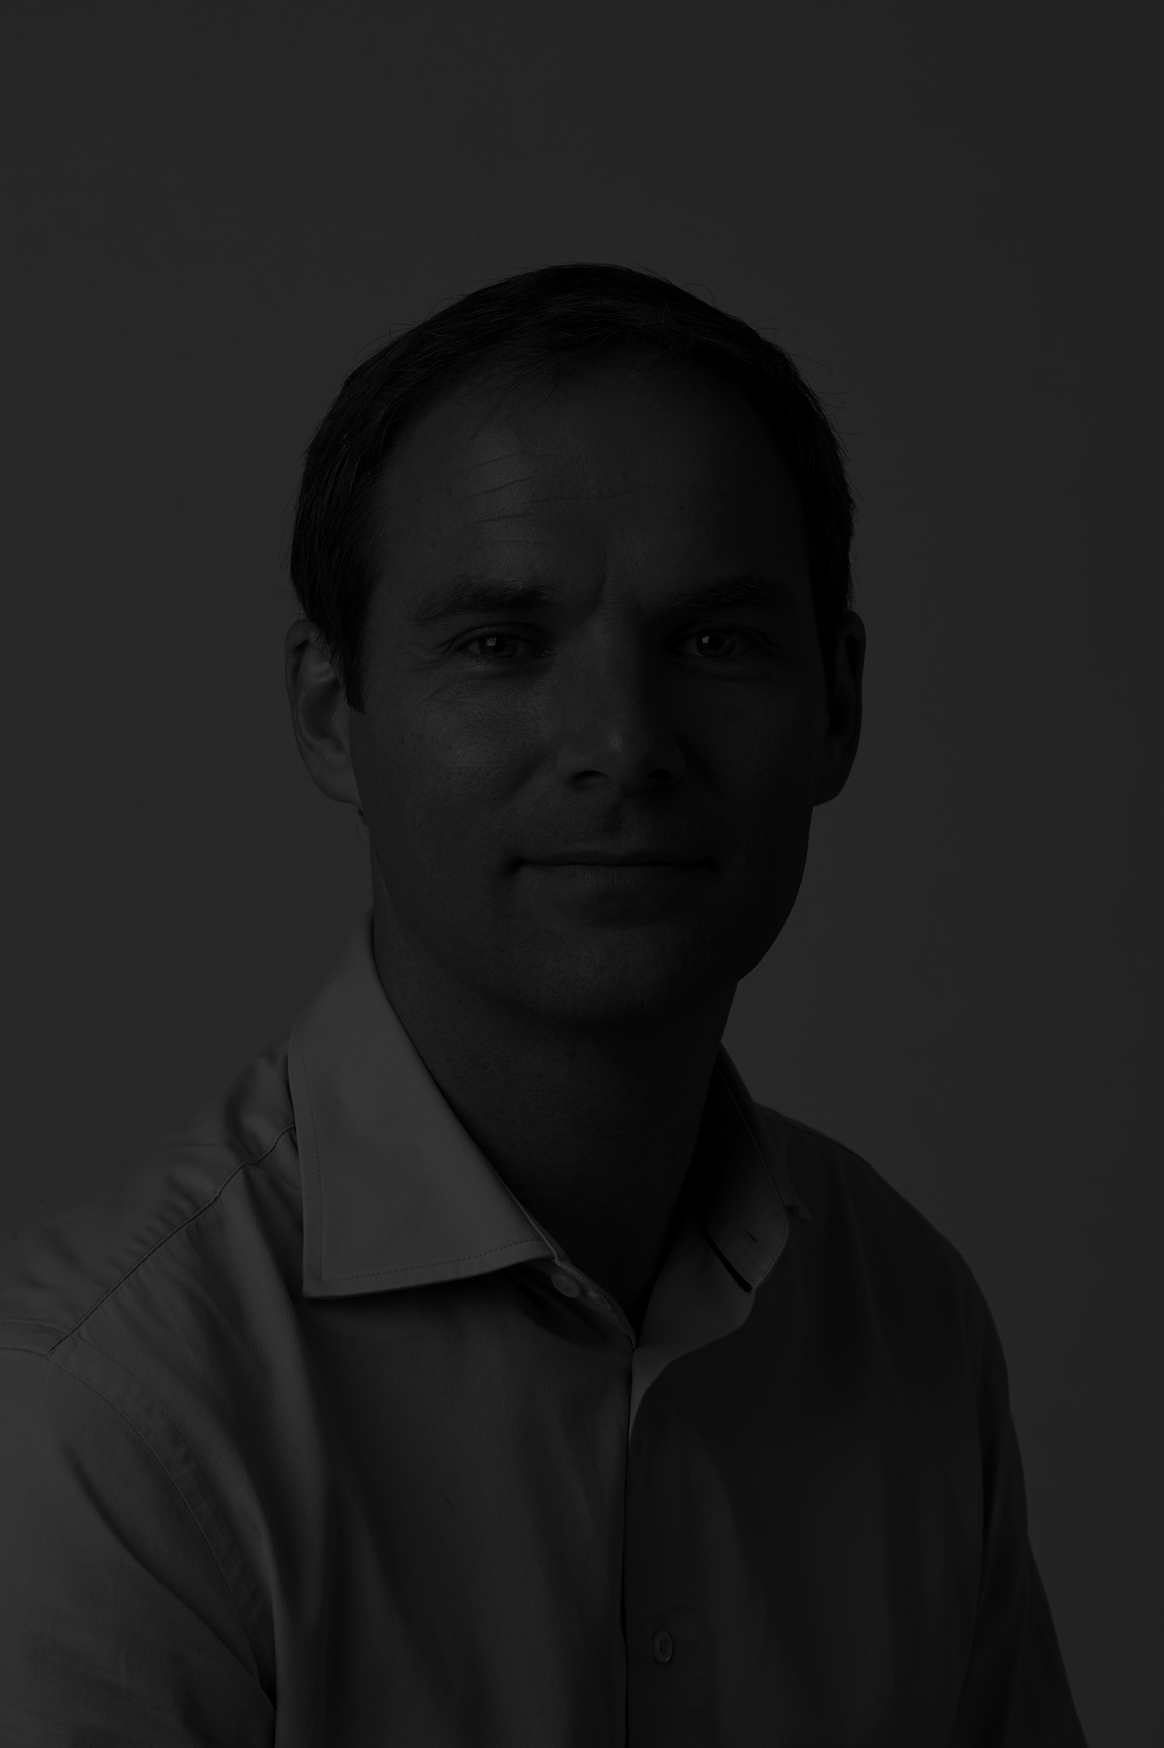

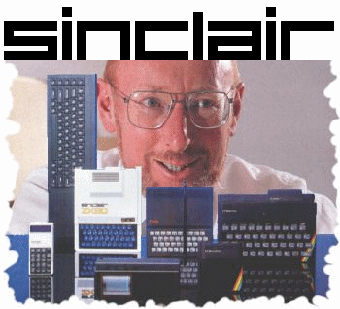
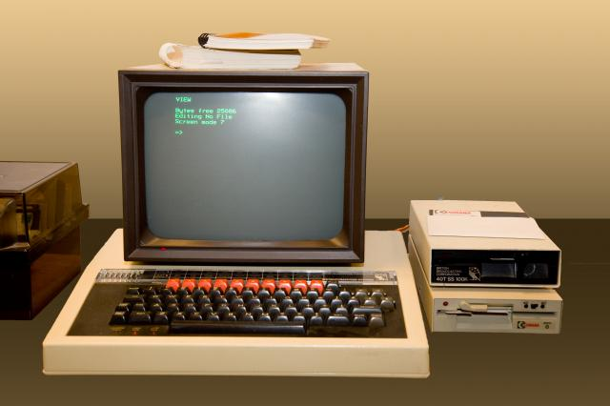
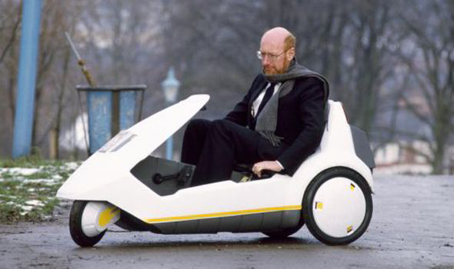
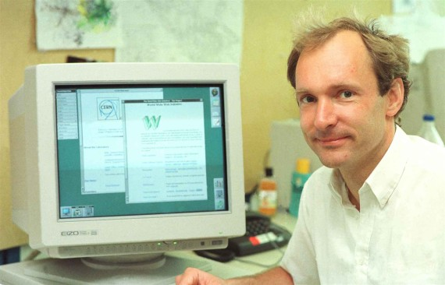
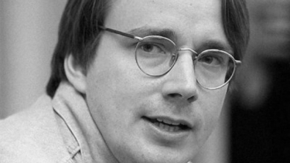
Scott Potter – To Autonomy & Beyond
A bit about me…
I started coding on one of these...
When he was still considered clever...
Before he released this!
My Engineering career started
the same year this man launched
the WWW to the public.
He launched Linux, and...
this phrase was coined!
Notes:
I started programming on BBC Micros
When Sir Clive Sinclair was still considered a genius.
...before the C5
Started my engineering career the same year as Sir TBL launched the WWW to the public
Linus launched Linux and….
The Term “Internet of Things” was coined.

Slide 9




Scott Potter – To Autonomy & Beyond
A bit about me
I’m currently consulting with Equal Experts
Previously Head of Engineering at News UK
Prior to that at some point… Xerox
Notes:
Read the slide
….with Xerox
So if I wind the clock back a quarter of a century
-- Next Slide --

Slide 10
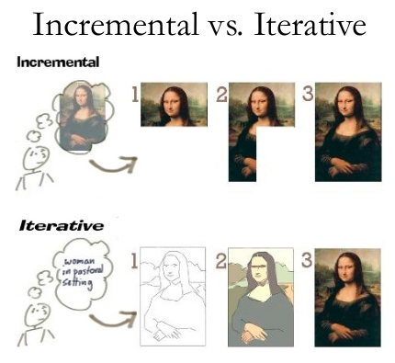
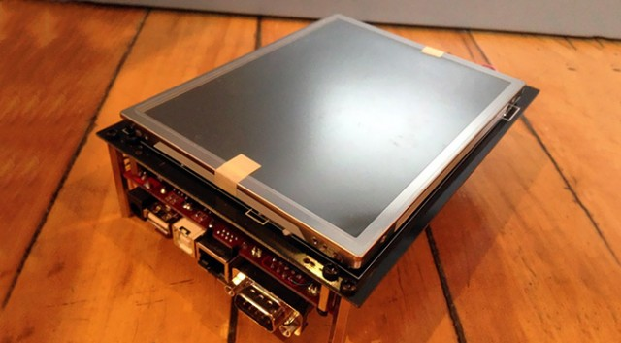
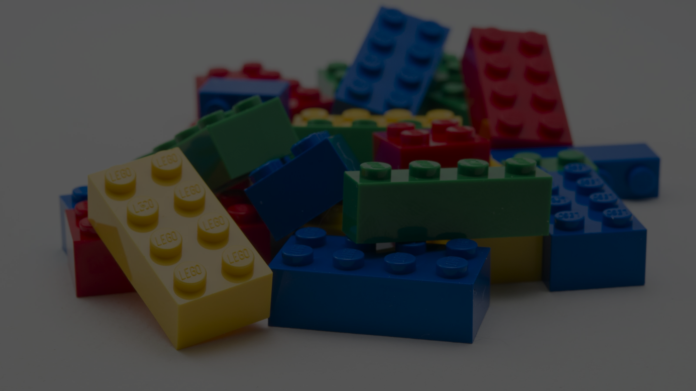
Scott Potter – To Autonomy & Beyond
Exploration & Prototyping
A bit about me
I’m currently consulting with Equal Experts
Previously Head of Engineering at News UK
Prior to that at some point… Xerox
Componentisation
Design for Reuse
Interfaces
Mechanical Design Engineer, R&D,
EVERYWHERE
Science based experimentation,
Electronic Engineering & Manufacturing Engineering
Notes:
Mechanical Design Engineer, R&D & Scientific Experimentation, Electronic Engineering & Manufacturing Engineering.
Iterative & Incremental, and exploratory methodologies were a given and instilled into everyone at Xerox
Componentisation, design for reuse & Defined interfaces everywhere
This just says, engineering - all of todays & the last decades talking points
Right Time, Right Place – fueled my gentle desire to challenge the status quo wherever I went…and this time it was in Sw Eng
-- next slide --
Moved to s/w eng in the 90’s

Slide 11
Scott Potter – To Autonomy & Beyond
Lean Software Development Black Belt
Engineer - Agile Coach
At News UK 4 years
Initiated dept. transformation in Oct 2013
Notes:
Just take Engineer 1st, Agile & Lean from this. Black Belt was 18 months, not 3 days.
From here on in I wont be talking tech – don’t want you to think that I’m coaching from the side lines.
…or worst still, not a techy. But I wont be mentioning Docker once.

Slide 12
Scott Potter – To Autonomy & Beyond
What Business Problem I’m trying to Solve
Notes:
The Business Problem
Lets start in Feb 2013 – a dark day in Digital – became known as The Valentines Day Massacre
Flagship new product based on a new & novel tech stack.
Been developed over 13 months after initial estimates of 4 months!...was released to the world. Expectations were high because
Was designed as a platform so it could power 100s of products for other News Corp brands around the Globe.
Initial launch was a disaster, defects, poor performance…although we turned things around within 3 weeks to stabilise the situation. But it was a wake up call.
This wasn’t reflective of the entire dept, the good work that me and a couple of my peers had done with our own teams was already starting to bear fruit. But, there was a fundamental problem with the setup and culture.

Slide 13

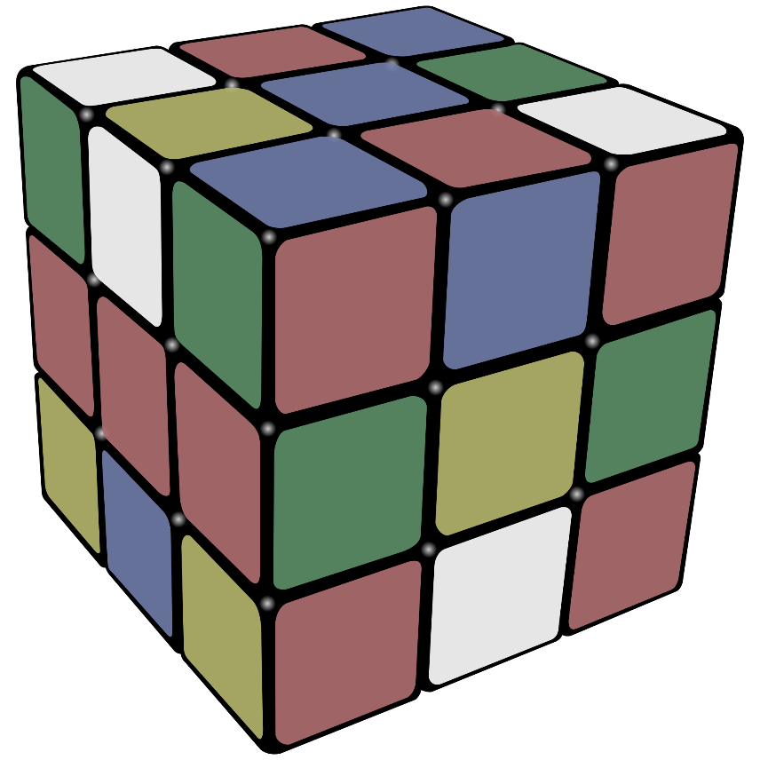
Scott Potter – To Autonomy & Beyond
What Business Problem Was I Trying To Solve?
The Business Problem
- Build a Digital Software Engineering dept.
...with a culture of quality, agile, based in London on average salaries
Notes:
I took over the Digital Engineering dept., a merger of the sw engineering and previously separate teams for QA and Infrastructure, Tooling & Systems Engineering.
- The merger was my suggestion.
-- Click –
The Business Problem – read the slide
-- Click ---
Nothing too big!!!!!
…On Average Salaries…..in an infamous Org!!!
Phrases like “We must have a culture of quality, but we must continue to move at speed”
-- Click --
Crikey, how do I go about this?
I should let you know, I’m not a career person, looking at the ladder planning my assent to take over the world.
The main reason I stepped up was: My like minded peers and I, had already made improvements in each of our own teams
- the thought of yet another change in management and direction ☹
As Steve Jobs said – “If you define the problem correctly, you almost have the solution”
--- Next Slide ---
Lets decompose the problem and the buzz words.

Slide 14

Scott Potter – To Autonomy & Beyond
What Business Problem Was I Trying To Solve?
Provide Business Agility
To provide adaptive software development which supports greater business agility:
(by releasing value early with quality and operational integrity)
(via practices such as xP, processes / frameworks such as scrum, tech, people, behaviours)
(early and continual feedback, able to pivot, accurate progress tracking as ‘Done’ means done)
To increase cash flow
To increase adaptability and agility
To reduce project risks
… With a vibrant culture that supports motivated staff, workforce stability and a real desire to continually improve standards.
And be able to sustain this.
This requires capable, motivated and correctly aligned people, working on tangible value.
Notes:
We must be Agile… ???? What does that mean? The industrialisation of Agile has caused great confusion and even fear.
Ok, tech and Digital products are at the centre of our future strategy and success. So we must support an agile Business.
What is Business Agility? This isn’t definitive but as a starter for 10
To increase cash flow
To increase adaptability and agility
To reduce project risks
So we know what practices can help provide this. [Click] But how do we actually do it?
Oh, and its people that will achieve this… so let’s add [click]
… With a vibrant culture that supports motivated staff, workforce stability and a real desire to continually improve standards.
And to be able to sustain this.
A culture of quality comes from capable people, who care and aren’t afraid to speak up if something isn’t right.

Slide 15
Scott Potter – To Autonomy & Beyond
Achieving DevOps from the Dev Side
Notes:
Ok… it’s a DevOps event, and this is about How To Achieve DevOps…. Or the benefits of practicing DevOps approaches.
I’ll take you through the headlines of my overall transformation…. Of which a DevOps mindset was central.
I make no apology for trying to stay away from many of the typical DevOps buzz words. I want to talk about the principles that drove my approaches.
???? – where to use this? Cross functional individuals, systems engineering and cloud based architecture, the benefits of micro services, responsibility of some operation and defining the requirements to support operability.

Slide 16

Scott Potter – To Autonomy & Beyond
Achieving DevOps from the Dev Side
Initiating Change
What does it mean to be an Engineer?
Core Competencies, Professional Behaviours
Initial step – what do I bring to this role?
Core Values: To Nurture, To Inspire, To Engineer, To Deliver
Direction & Leadership
Vision & Identity
Notes:
Ok, wind the clocks back to Spring of 2013, I had just taken over the newly merged Engineering dept.
-- The way I’ve described the problem, you’d be forgiven for thinking that I was starting from scratch. But infact there was something in place, people in roles and in teams, with line managers, Product Owners.. And an existing culture. This was definitely a transformation.
SO how did I start?
…at the very beginning – click – What do I bring? And what’s missing? – reverse engineered what had gone so well so far at News…after all, was bought in for my Engineering Expertise and wasn’t actually doing much engineering. Click - Core Values : Are these values? Well I value them, in balance
I should be doing something for all 4, daily.
With heavy recruitment, key positions not filled and some big developments to complete… we were still in a Holding Pattern.
I could picture what I wanted the dept. to look like, I could see success. But I’d be lying if I said I had a clear plan of how to bring about this change.
In the SUMMER click
I held an offsite day with each team and amongst other activities, asked them what they wanted to be…what they wanted to be recognised for… click
Essentially, their Collective Identity, which also helped them envision the future.
This was the start of the journey for us all coming together around a common goal, to become outstanding. Those that didn’t want to strive for this, knew that their colleagues did… and change was inevitable.
Throughout, I was trying to lead by example and set expectations – click -- of high standards, structured problem solving, able to work with others, don’t expect ‘testers’ to find the defects in your work…is that not embarrassing? –click– the ones that cared, rose to this challenge.

Slide 17
Scott Potter – To Autonomy & Beyond
Achieving DevOps from the Dev Side
Initiating Change
Reorganised to ensure that:
Every Team was aligned to a set of real users
Every Team was as cross functional and autonomous as possible
Every Team had a core of permanent staff
Done with full collaboration with my 4 Engineering Managers
Notes:
I knew that I wanted a feeling of belonging, that you knew what all the people around you were working on…infact, lets not set the bar too high, to know their name.
Things like co-ordinating training so that people from different teams attended together, to bridge the gaps between teams and break the silos.
Simple Tech talks, Lunch & Learn sessions.
By October of the same year, I had
Reorganised to ensure that:
Every Team was aligned to a set of real users (And they knew what the ‘whole’ looked like)
Every Team was as cross functional and autonomous as possible (minimise dependencies on others to be able to do your job and deliver real value to the business)
Every Team had a core of permanent staff
Look at my 3 year plan
Redefine the companies career framework
Implement training and development structure
Cotter’s change model…and others. Create an env. Capable of change – create an appetite for change

Slide 18
Scott Potter – To Autonomy & Beyond
Achieving DevOps from the Dev Side
Phases 1 & 2
Stabilise
Recruit
Grow Competencies (Engineering Excellence Model)
Retain Key Staff
Increase Productivity
Strive for Engineering Excellence
Provide Great Careers
Notes:
Run through both phases.
My Priorities may be different to yours, I based mine on what I had at my disposal, who I had, what I needed to introduce, eradicate or evolve.
You’ll note this thing called EEM, I’ll come on to that next. Comment about all Models being wrong, this was a communication tool but also to help me be mindful of all aspects that needed consideration…because days can very often be frantic.
1
Stabilise
Recruit
Grow Competencies (Engineering Excellence Model)
Retain Key Staff
2
Increase Productivity
Strive for Engineering Excellence
Provide Great Careers

Slide 19
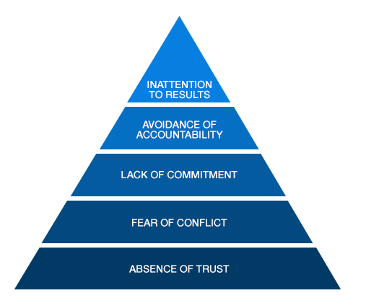
Scott Potter – To Autonomy & Beyond
Achieving DevOps from the Dev Side
Engineering Excellence Model
Environment
Capabilities & Behaviours
Values
Vision & Identity
Notes:
You might recognize this from a few moments ago….and if you’re familiar with NLP. I’ve adapted it from self to a collective, and for my needs
Summarise the foundation, work up
Capabilities - The knowledge, skills and experience we can draw upon, both technical and interpersonal
Behaviours - How we conduct ourselves.
- How we utilise our own & our teams capabilities to: Continually increase the flow of real value to the business
Behaviour is heavily influenced by levels of motivation.

Slide 20
Scott Potter – To Autonomy & Beyond
Achieving DevOps from the Dev Side
Engineering Excellence Model
The Skill
Technical Agility
Organisational Agility
Process Agility
Personal Agility
The Will
Sense of Purpose
Autonomy
Opportunity to Grow
Environment
Capabilities & Behaviours
Values
Vision & Identity
Notes:
Dive into this layer:
Skill & Will
..and a DevOps setup plays a part in all of these.

Slide 21
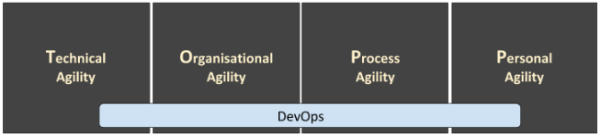
Scott Potter – To Autonomy & Beyond
Achieving DevOps from the Dev Side
Engineering Excellence Model
Environment
Capabilities & Behaviours
Values
Vision & Identity
Notes:
Dive into this layer:
Skill & Will
..and a DevOps setup plays a part in all of these.

Slide 22

Scott Potter – To Autonomy & Beyond
Achieving DevOps from the Dev Side
Systems Engineering & DevOps Strategy
An Extract from a communication
The objectives of this strategy are to:
● Ensure that each development team is as self sufficient as possible,
● Ensure that each development team is cross functional & resilient, with no single points of failure,
● Create an environment of ownership behaviour where teams:
are empowered,
have flexibility,
build up trust to rely upon one another,
to be able to challenge one another and therefore continuously improve,
● Sufficient knowledge to design end-to-end systems more successfully than was previously capable,
● Ensure teams are able to respond to changing requirements,
● Avoid poorly designed & hard to use environments and stacks experienced from a pooled sys eng team.
Notes:
Key points: Self Sufficient, No Single Points of Failure, Feel Accountable and have the authority to do what they need to do and with this, take responsibility for their actions & output.
An individual systems engineer specialises but most scrum team members are competent at designing and building cloud based infrastructure and architecture.
With Infra as sw, there was benefit in infra and systems engineers working with experienced sw engineers to develop highly maintainable infrastructure through sw.
…..anyway, I said I wasn’t going to cover the standard techy stuff.
There was still a separate 24-7 Ops team (that we work closely with), protecting their production estate. Great guys who have been left holding the baby in the past.
As such, typical behaviours and processes were in place to make it impossible to release and therefore minimise things breaking…… I mean err, easy to release, but not too often, and with manual steps & sign-offs.
We need to prove ourselves. I haven’t even used the term DevOps until now.

Slide 23
Scott Potter – To Autonomy & Beyond
Achieving DevOps from the Dev Side
Establishing High Performing Teams
They have a common goal
High Standards & Expectations
Able to Resolve Conflict
Frequent Feedback, Team-based rewards
Notes:
Establishing High Performing Teams
What needs to be in place and what behaviours are required?
The team learn and control the Levers (control factors) that they can adjust to perform better.
The team learn which elements of their working environment (noise factors) are out of their control and they simply need to be robust to.
Common Goal
Establish Goals. Teams need to be focused on shared goals and outcomes. Commitment to that goal is essential for success.
Focus on the Collective Mission. Mission-driven teams and organizations perform better because they see beyond their individual workload and tasks and feel as if they are working for a higher purpose.
High Standards & Expectations
Determine How The Team Will Make Decisions. Whether directed or democratic, the team needs to understand beforehand how decisions will be made. This reduces conflict within the team when a decision has to be made.
Create a Learning Environment. Emphasize the development of the team, learning through successes, but particularly through mistakes. A team with a culture of continuous improvement and where members are motivated to develop their skills and knowledge are high-performing teams.
Team members have agreed and know what to expect from one-another.
All members are able to handle and resolve problems and conflict in the moment.
Demonstrate ‘Ownership’ behaviour and each has a ‘resourceful state of mind’
All members take the responsibility to hold each other accountable.
Output
Provide Clear and Constant Feedback. Teams need to know how they are doing in order to stay motivated and to correct performance problems or inefficiencies. The more feedback loops the better.
Use Team-Based Reward Systems. Too much emphasis on individual rewards can lead to in-fighting and resentment. A combination of individual and team-based rewards is often best.

Slide 24
Scott Potter – To Autonomy & Beyond
Achieving DevOps from the Dev Side
Establishing High Performing Teams
They have a common goal
High Standards & Expectations
Know what to expect from one another
Able to make decisions
Culture of learning & improvement
Personal Responsibility & Ownership behaviour
Have a ‘resourceful state of mind’
Take the responsibility to hold one another accountable
Able to Resolve Conflict
Frequent Feedback, Team-based rewards
Notes:
There’s some more detail that I’m not going to run through, but as you read, I’ll just say that: Why would an individual want to be part of a high performing team?
Why would they want to have that difficult conversation and hold their teammates to account, stick their neck out to protect one another - what’s in it for me? (The WIIFM Factor)
To increase our predictability and the company’s trust in us. With trust comes responsibility and empowerment.
Agile culture
“What does an agile company culture look like? It starts with a basis of trust. Management trusts that the best solutions emerge from having the right people collaborate with each other.”
Reduce the frustration
Take more control of matters
Have a clear purpose
Reduced delivery pressure gives time to focus on process, product and people improvements
Feel Productive, motivated, empowered.
Make higher quality decisions and accomplish more in less time and fewer resources
Put critical topics on the table and have lively meetings
Be Respected and valued.
Listened to
Get to work on the interesting and important things
Able to say no
Be included in part of the broader conversation and strategy and not simply be provided with a solution to implement
--- next slide ---
Other considerations, a common purpose across an org to help bring together differen thinking.

Slide 25
Scott Potter – To Autonomy & Beyond
Achieving DevOps from the Dev Side
What do we all have in common? What are we trying to achieve?
To Ensure our Employers / Our Company can produce and provide products or solutions that successfully meet their customers needs (better than our competitors).
To do so in a cost effective and timely manner.
To do so such that it supports the business needs, goals and ambitions.
To be able to do this consistently and sustainably.
Notes:
Just another consideration.

Slide 26
Scott Potter – To Autonomy & Beyond
What Did We Achieve? What can I observe? Leading KPIs
Close collaboration - share the problem to be solved or the desired outcome and work through it together. No dictating of solutions, architectures or process.
Frequent, continuous and quick feedback to amplifying learning. We all know more today than we did yesterday. How much more can we learn? How can we derisk a complex project or product build?
Empowered teams are essential as they know the most about the options available and are more motivated when closely aligned to and able to influence the outcome.
Empowered teams can also ensure that they only do what is needed and no more, keeping solutions as simple as possible, making time to market quicker and enhancement and maintenance easier.
Micro services architecture:
Release working software early & often to increase feedback, and opportunity to learn and optimise the product.
Initiate new builds with the lightest build and deployment pipeline to production.
Prove the technology choices, base architecture, processes and tooling as early as possible so that be every subsequent product increment is known to be a true, complete increment (no more work required).
Notes:
What I aimed for, to achieve the transformation and resulting improvements.
PROOF IS IN DELIVERING, NOT IN GREAT PROCESSES OR ARCHITECTURES.
NOT and exhaustive list
Just pull out the key points
EMPOWERED TEAMS:
Each and every one has their ‘skin in the game’. They have the context, insights and expertise to be able to help one another out. They can rely on one another.
Greater availability & security
Quality first

Slide 27
Scott Potter – To Autonomy & Beyond
What Next?
Notes:
What is my role as a Manager? As a Leader? This shouldn’t be a cause for concern

Slide 28
Scott Potter – To Autonomy & Beyond
What Now?
As a Leader / Senior Manager, do I still have a role to play?
Notes:
You should be able to see things that others can’t, you’re looking across many teams
You can see common trends, differences (Positive deviations)
Consider that you now have a good signal to noise ratio and you can now amplify this.
We talk about Leaders and not Managers these days. Know the difference and apply it, but don’t be afraid of the term management – some situations also require managing.
Be aware of motivation and having a sense of relatedness / purpose. – the way people and teams are aligned to delivering real value with as much autonomy as possible.

Slide 29
Scott Potter – To Autonomy & Beyond
What Now?
Nice Problems to Have
Notes:
With Autonomy comes the risk of divergence – but this brings about different practices and learnings.
Natural governance for CD and autonomy when capable and then catalyse natural convergence (part of the ‘beyond’)
Allowing tech such as Node JS, being single threaded it suggests delegation and encourages thinking to drive micro-service
Be responsible for the decisions. I.e was is the right time? We did a trial of typescript but at the time we didn’t allow REACT js as an investigation (I still need the engineering skills to weigh up the pros and cons as others may be biased by the ‘Resume Drive Architecture’ approach). Too early.

Slide 30
Scott Potter – To Autonomy & Beyond
What Now?
Building a New Culture, with Resilience

Slide 31

Scott Potter – To Autonomy & Beyond
What Now?
The Pendulum
Under-damped
Process
Product
People are always the common factor.
People
Capable & Motivated people who can assist one another at the coal-face and rely on one another.
The proof is in delivering value, frequently and sustainably.

Slide 32
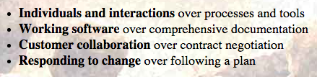
Scott Potter – To Autonomy & Beyond
What Now?
Personal Agility
The Agile Manifesto
Underlying structure based on Patrick Lencioni’s 5 Dysfunctions of Teams:
Absence of Trust
Fear of Conflict
Lack of Commitment
Avoidance of Accountability
Inattention to Results
Notes:
32

Slide 33
Scott Potter – To Autonomy & Beyond
What Now?
Personal Agility
Low Standards
Artificial Harmony
Notes:
I think that high performing teams require their members to participate in relationships based on trust.
33

Slide 34
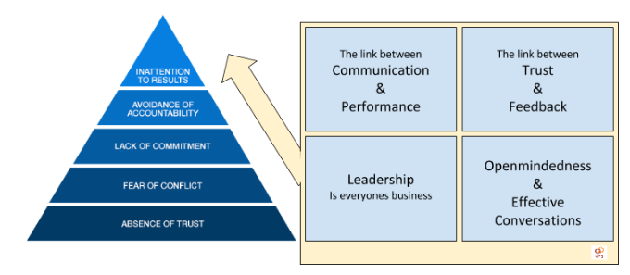
Scott Potter – To Autonomy & Beyond
What Now?
Personal Agility
Notes:
34

Slide 35
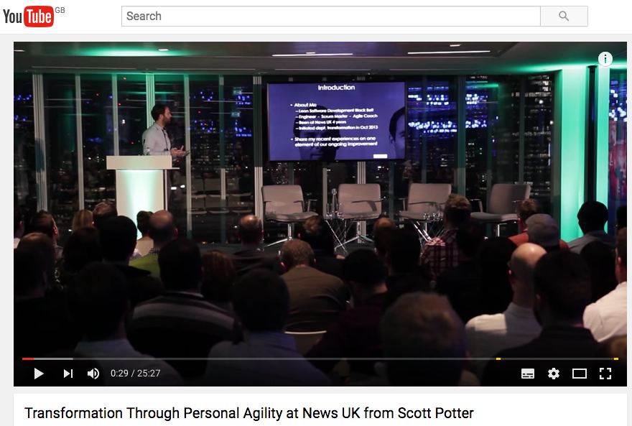
Scott Potter – To Autonomy & Beyond
What Now?
Personal Agility
Notes:
35

Slide 36
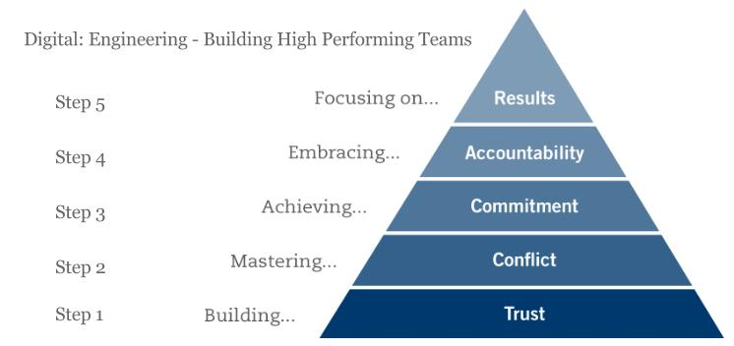
Scott Potter – To Autonomy & Beyond
What Now?
Personal Agility
Notes:
36

Slide 37
Scott Potter – To Autonomy & Beyond
Takeaways
Stabilise
Recruit
Grow Competencies (Engineering Excellence Model)
Retain Key Staff
Increase Productivity
Strive for Engineering Excellence
Provide Great Careers
Environment
Capabilities & Behaviours
Values
Vision & Identity
Notes:
Remember, this is all with hindsight. I had a plan and it evolved as I learnt more.
“Anyone who has never made a mistake has never tried anything new” – Albert Einstein.
DevOps plays a significant part in achieving Business Agility:
Technical, Organisational and Process Agility
Don’t forget the skills individuals need to help their team become high performing
When initiating change, refer to models but consider your circumstances, situation, weapons to hand
The Common Goal
Beware of ‘Artificial Harmony’
5 Dysfunctions of a Team and importance of

Slide 38
Scott Potter
To Autonomy & Beyond
Thank you

